Slide 1
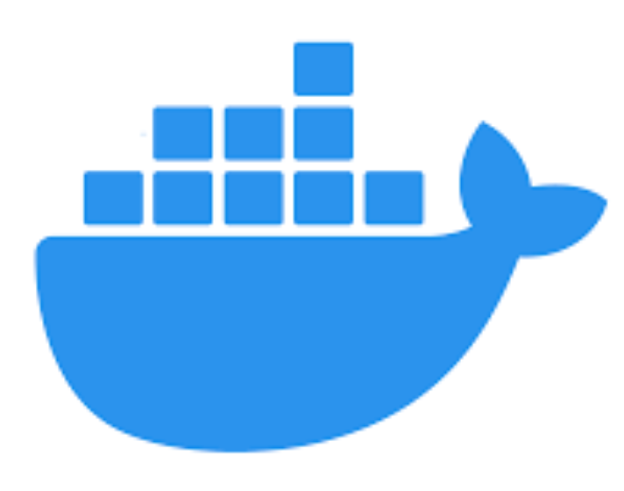


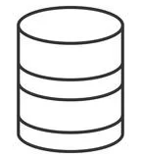




Heroku
AWS
Web App Front End
Docker Container
RDS
Web Server
User/Patient
Docker Container
API
Mobile App Front End
SMS Notification
Lambda

